Slide 1
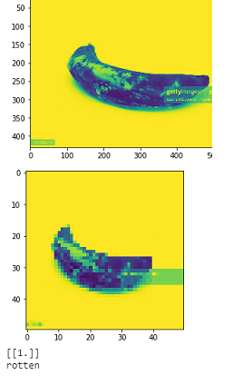
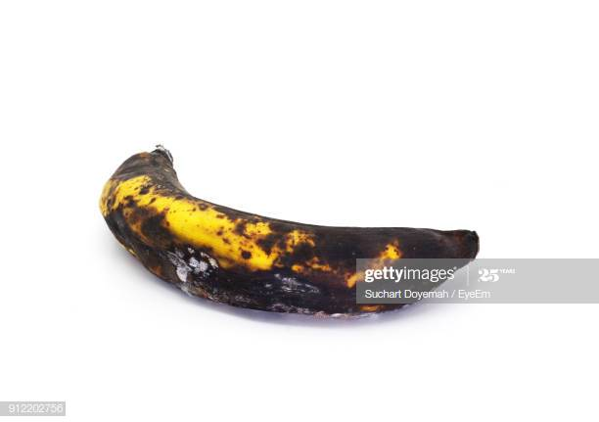
TEST RESULTS
Link for test:https://www.kaggle.com/sriramr/fruits-fresh-and-rotten-for-classification
Test Example 1:
Rotten

Slide 2
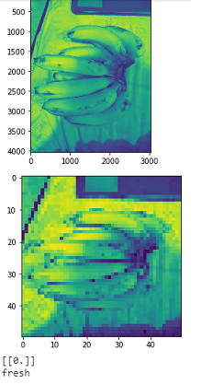
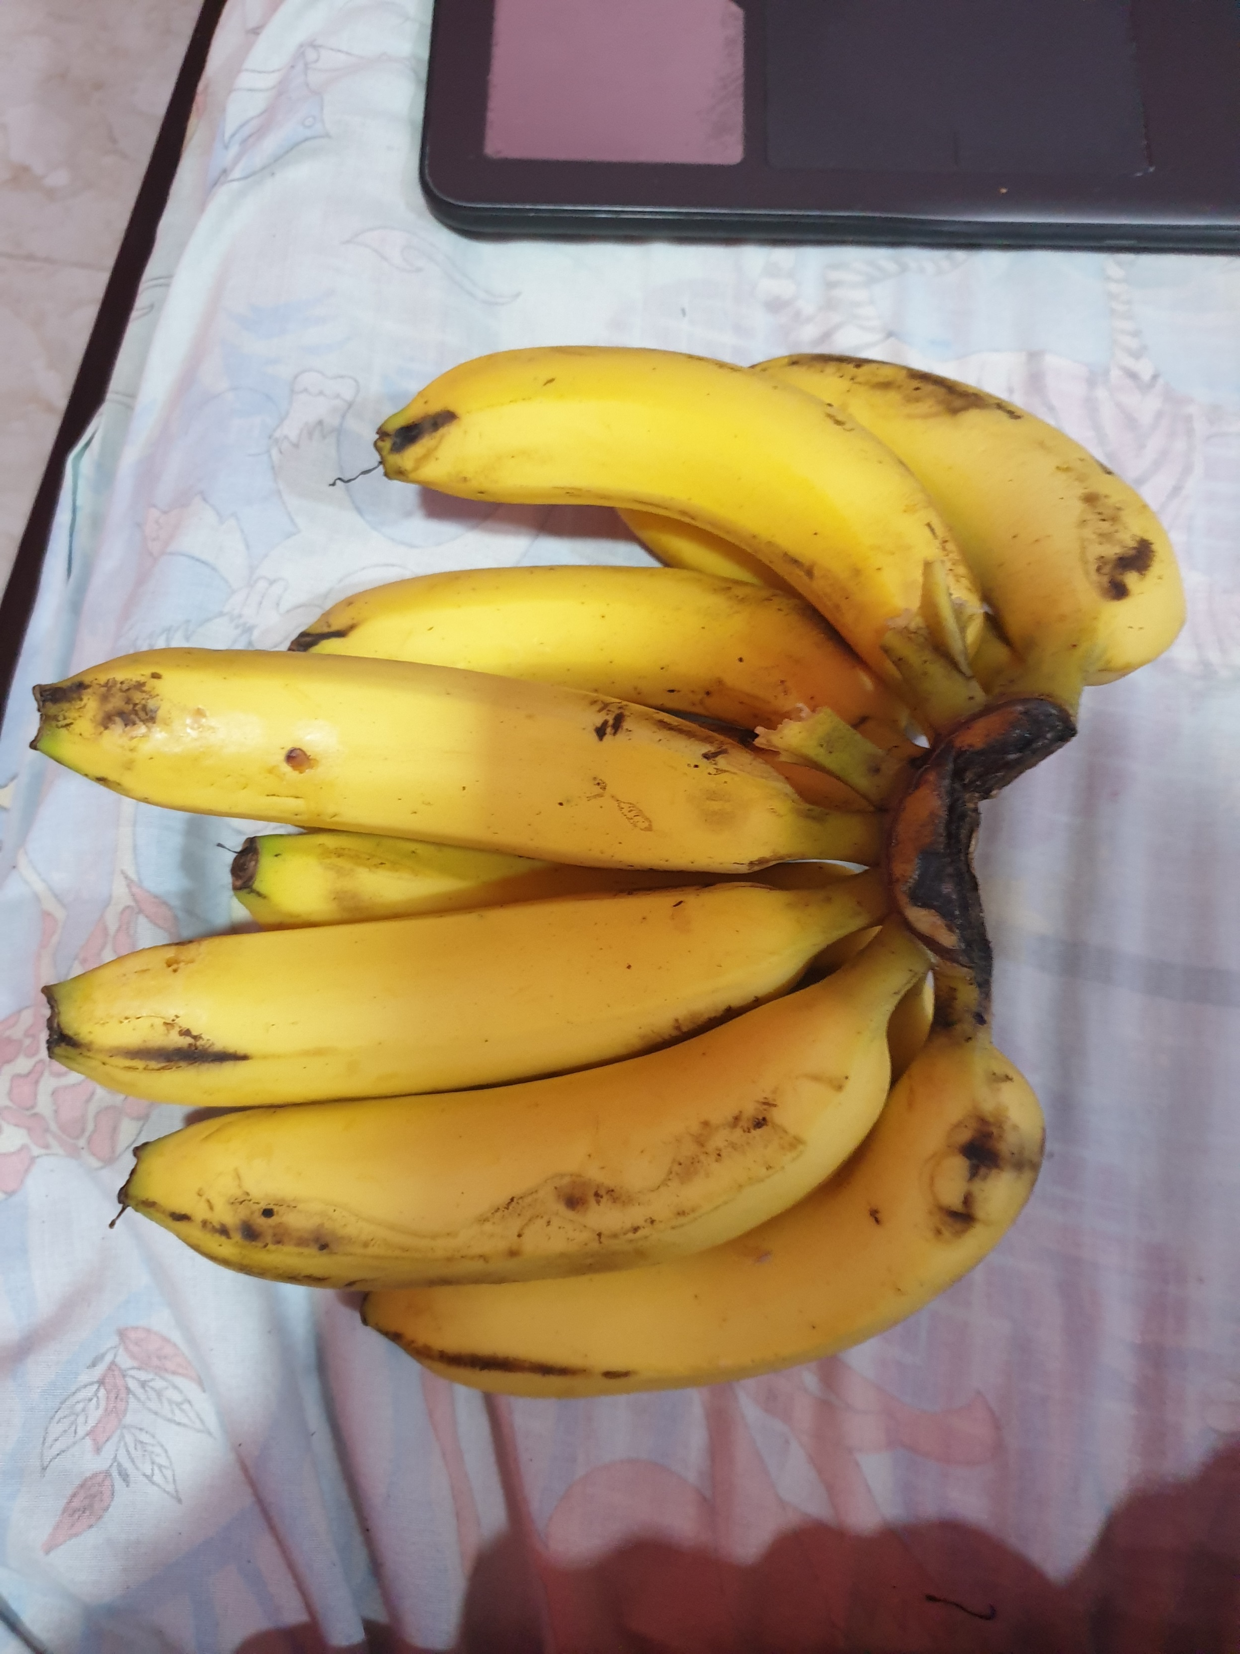
Test example 2:
Fresh

Slide 3
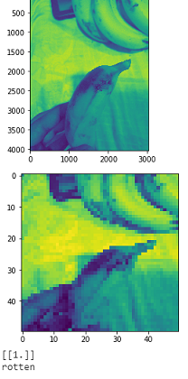
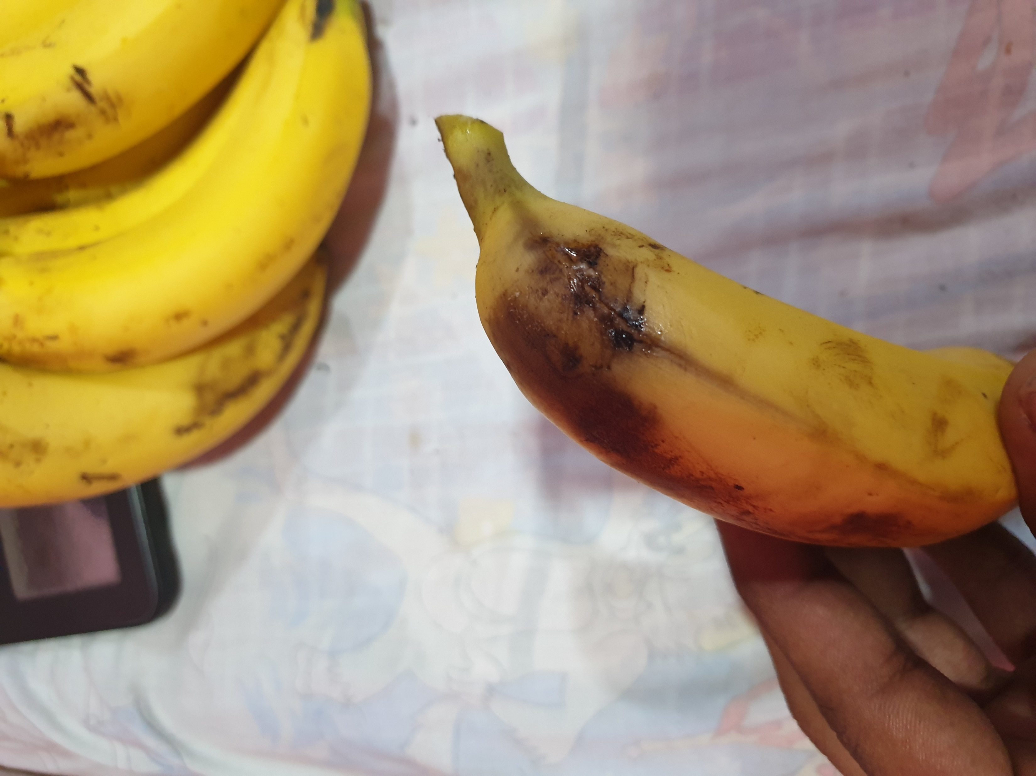
Test example 3:
Rotten

Slide 4
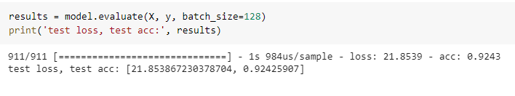
Test Accuracy

Slide 5
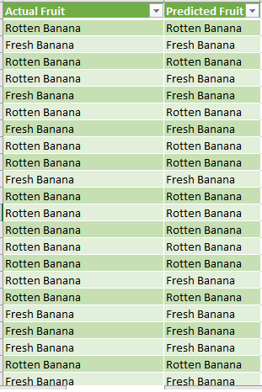
Csv file of test results

